Slide 1

Weather Prediction
PREDICTING WEATHER FORECAST BASED ON MACHINE LEARNING
Department of Computer Science and Engineering,
KIET GROUP OF INSTITUTION, GHAZIABAD, U.P., INDIA
Mentor:
Mr. Manish Gupta
Team Members:
Sagar Kumar(1802910133)
Sameeksha (1802910136)
Himank Anchal(1802910076)
Notes:
Photo by Sean Pollock on Unsplash

Slide 2

Table Of Contents
1. Acknowledgement
2. Team Members
3. Introduction
4. Roadmap
5. Project Analysis
6. Data Analysis
7. Code Analysis
8. Conclusion and Result
9. References

Slide 3

Acknowledgement
We would like to show our highest gratitude towards
Mr. Manish Gupta Sir for sharing his immense knowledge with us and guiding us each and every time we were in any problem regarding the project. We would also like to thank CSE department for giving us such a great opportunity and providing us a mentor who guides us in every situation.
Thank You
Mr. Manish Gupta (Mentor)

Slide 4
Introduction
Each one mindful of todays condition because of absence of spotlight on nature todays environment condition changes excessively fast and we can say ceaselessly from one side of the planet to the other todays world exact anticipating of weather conditions are significant. Still everybody lives totally relies upon the climate accessibility and there economical endurance in any event, for premise need for endurance for cultivating to producing, for customary voyaging, taking into account that the whole planet is encountering day to day natural changes and its ramifications that is the reason it is vital to ensure day to day tasks that are basic and smooth as well as fast and functionable and consistent spryness. Considering that the climate of one spot region most certainly influences the condition in another locale since weather patterns framework can steer trip a distant in every one of the headings slowly. That is the reason climate of one region can impact the climate state of other. Here we propose a strategy for estimating whether conditions by gathering all substantial data from research as well as assortment of verifiable information connected with climate from various areas.
By brushing every one of the legitimate gathered information and use it to prepare AI model that can precisely conjecture the climate for the legitimate expectation. This basic model sudden spike in demand for minimal expense ,low-asset processing framework while as yet giving exact quick and solid information result for conjecture that can be utilized in our regular routines.

Slide 5

What is
Data Science?
Data science is an interdisciplinary field that uses scientific methods, processes, algorithms and systems to extract knowledge and insights from structured and unstructured data, and apply knowledge and actionable insights from data across a broad range of application domains. Data science is related to data mining, machine learning and big data.

Slide 6
What is
Weather Prediction?
Weather Prediction is a quite difficult task. The Wiki said,“ Weather Prediction is the application of science and technology to predict the conditions of the atmosphere for a given location and time. Weather Prediction are made by collecting quantitative data about the current state of the atmosphere at a given place and using meteorology to project how the atmosphere will change.”
So in general, weather prediction is about the data about the atmosphere. Of course, I would not model the atmosphere condition, but I can use a lot of data about it for weather prediction.

Slide 7
Basic Roadmap Behind the project
Collecting Data
I
Collecting all the data in the JSON file or applying any API.
Analyzing the data
Now we will analyze the data according to our needs.
II
Final Prediction with model
III
Now we can predict the weather according to the model we have trained.
Importing On Android Studio.
Now we can predict the weather according to JSON file linked with API platform
IV

Slide 8
Project Analysis
Fast development in field of the product applications correspondence innovation and equipment obviously. This improvement assists in a different ways with working on the web associated world turn of events and assist the tactile gadget with arising. This will incorporate genuine world information and data estimations and the perception.
Generally web associated gadget is utilized by 2022 is expected to be under 25 and 25 billion in contrast with the previous results as we as a whole mindful about the innovation it is normal that the web associated contraptions will build innovation will develop . and furthermore development of the distributed information.
Internet of things (IOT) innovation which is used in the all web associated advancements or on the other hand the gadgets to keeps on expanding the current web by allowing connection in between the physical and the digital world. As the web of things turns out to be more handily presented due to the less definitively detecting units and upgraded cooperation and furthermore the substantial range that can give the significant continuous climate forecast in a total subtleties will logical develop significantly. This gadgets assists with rising the innovation in a positive bearing to help the group of people yet to come lives .

Slide 9

Data Science behind Weather Prediction
Satellite Imagery and Sensor Data
Today, the primary source of atmospheric science is satellite imagery and that does not mean pretty pictures though!
Satellite imagery comes in different sizes and shapes. Some satellites operate in the black and white spectrum, some can be useful to identify and measure clouds, others to measure winds over the oceans. Most data scientists rely on satellite imagery to generate short term forecasts, to determine whether a forecast is correct, and to validate models too.
Predictive Modeling and Machine Learning
Weather models are at the heart and they are used both for forecasting and to recreate historical data. However, over the last decade, machine learning has increasingly come to be applied in atmospheric science.
Data – A Crucial Part of Weather Predictions
It is necessary to have the right data to be close to accurate decisions. The data needs to be taken with respect to the location and the time at which it is noted has to be considered. Today, all the devices are IoT-enabled with gyrometer, barometers and all sorts of sensors in it. So, the location from one standpoint to another is very well available. Therefore, mobile phones proved to be revolutionizing the analytics weather industry and they have really changed the industry.
Weather Data – An Aid for many Events
Prediction of Floods and Natural Disasters – Floods and other natural disasters can be predicted by weather data analytics using models. This requires collecting data like the surrounding road condition and the rainfall of the area that year.

Slide 10
Data analysis of Different Regions in the world according to 5 attributes Temperature. Humidity. Wind Speed. Pressure. Feelslike

Slide 11
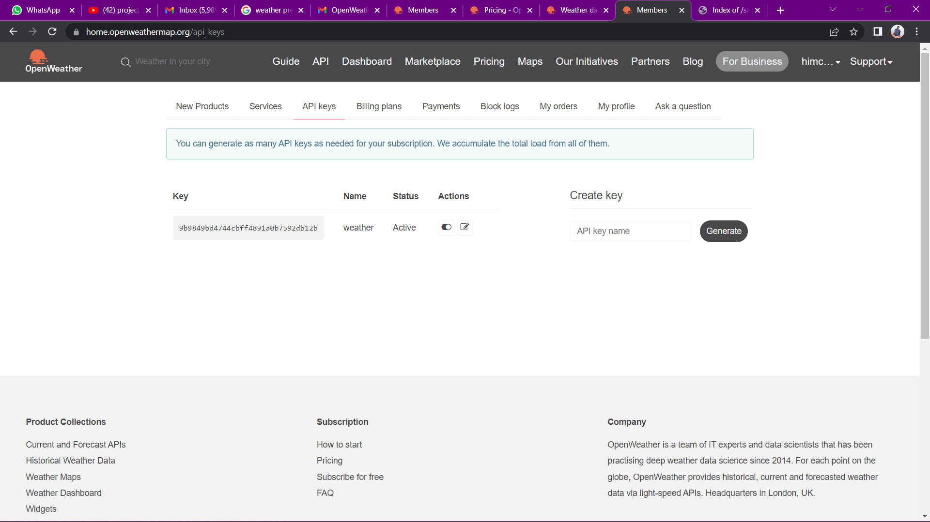
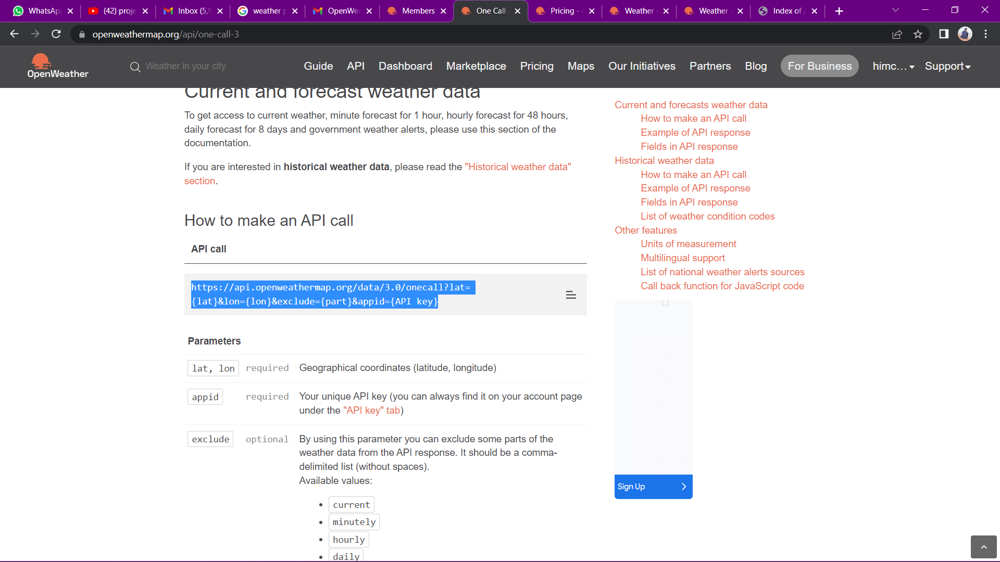
API

Slide 12
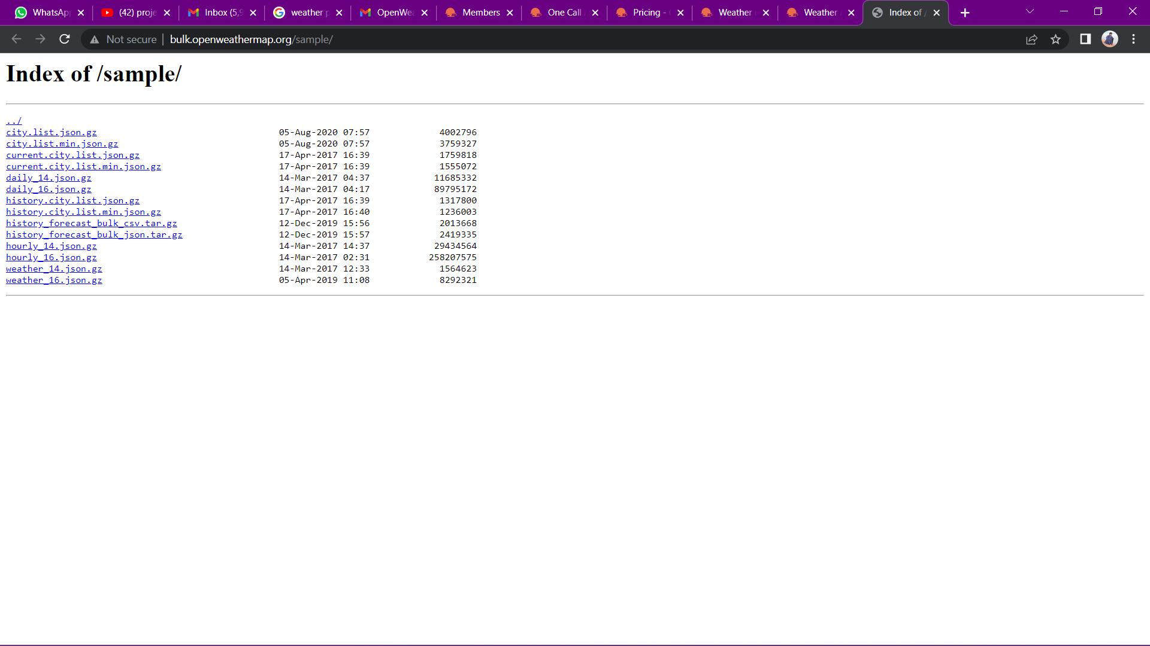
JSON file

Slide 13
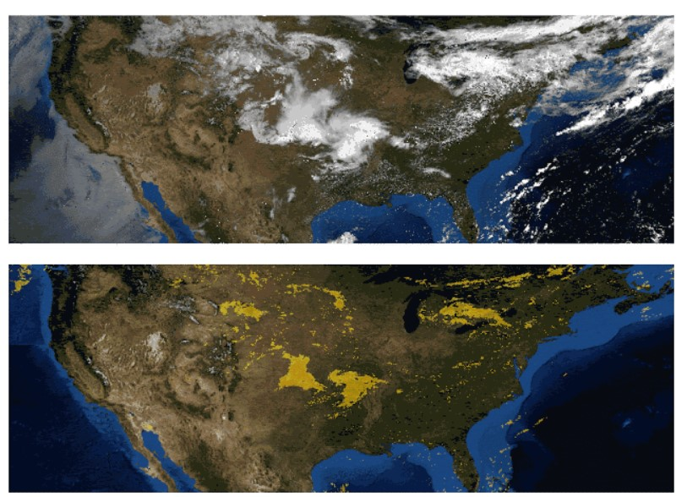
RADAR IMAGES

Slide 14

World Map
Data Analysis is done on the different continents of the world

Slide 15
Temperature Analysis
Asia Region
Maximum Temperature:
It is the maximum temperature recorded on every day according to every month of year 2019.
Average Temperature:
It is the average temperature recorded on every day according to every month of year 2019.
Minimum Temperature:
It is the minimum temperature recorded on every day according to every month of year 2019.

Slide 16
Humidity and Wind Speed Analysis
Humidity:
It is the average humidity observed
on a day in the year of 2019.
Wind Speed:
It is the average wind speed observed
on a day in the year of 2019.

Slide 17
Temperature Analysis
Antarctica Region
Maximum Temperature:
It is the maximum temperature recorded on every day according to every month of year 2019.
Average Temperature:
It is the average temperature recorded on every day according to every month of year 2019.
Minimum Temperature:
It is the minimum temperature recorded on every day according to every month of year 2019.

Slide 18
Humidity and Wind Speed Analysis
Humidity:
It is the average humidity observed
on a day in the year of 2019.
Wind Speed:
It is the average wind speed observed
on a day in the year of 2019.

Slide 19
Temperature Analysis
North America Region
Maximum Temperature:
It is the maximum temperature recorded on every day according to every month of year 2019.
Average Temperature:
It is the average temperature recorded on every day according to every month of year 2019.
Minimum Temperature:
It is the minimum temperature recorded on every day according to every month of year 2019.

Slide 20
Humidity and Wind Speed Analysis
Humidity:
It is the average humidity observed
on a day in the year of 2019.
Wind Speed:
It is the average wind speed observed
on a day in the year of 2019.

Slide 21
Temperature Analysis
South America Region
Maximum Temperature:
It is the maximum temperature recorded on every day according to every month of year 2019.
Average Temperature:
It is the average temperature recorded on every day according to every month of year 2019.
Minimum Temperature:
It is the minimum temperature recorded on every day according to every month of year 2019.

Slide 22
Humidity and Wind Speed Analysis
Humidity:
It is the average humidity observed
on a day in the year of 2019.
Wind Speed:
It is the average wind speed observed
on a day in the year of 2019.

Slide 23
Temperature Analysis
Europe Region
Maximum Temperature:
It is the maximum temperature recorded on every day according to every month of year 2019.
Average Temperature:
It is the average temperature recorded on every day according to every month of year 2019.
Minimum Temperature:
It is the minimum temperature recorded on every day according to every month of year 2019.

Slide 24
Humidity and Wind Speed Analysis
Humidity:
It is the average humidity observed
on a day in the year of 2019.
Wind Speed:
It is the average wind speed observed
on a day in the year of 2019.

Slide 25
Temperature Analysis
Africa Region
Maximum Temperature:
It is the maximum temperature recorded on every day according to every month of year 2019.
Average Temperature:
It is the average temperature recorded on every day according to every month of year 2019.
Minimum Temperature:
It is the minimum temperature recorded on every day according to every month of year 2019.

Slide 26
Humidity and Wind Speed Analysis
Humidity:
It is the average humidity observed
on a day in the year of 2019.
Wind Speed:
It is the average wind speed observed
on a day in the year of 2019.

Slide 27
Temperature Analysis
Australia Region
Maximum Temperature:
It is the maximum temperature recorded on every day according to every month of year 2019.
Average Temperature:
It is the average temperature recorded on every day according to every month of year 2019.
Minimum Temperature:
It is the minimum temperature recorded on every day according to every month of year 2019.

Slide 28
Humidity and Wind Speed Analysis
Humidity:
It is the average humidity observed
on a day in the year of 2019.
Wind Speed:
It is the average wind speed observed
on a day in the year of 2019.

Slide 29




Introduction
Platform Used

Slide 30

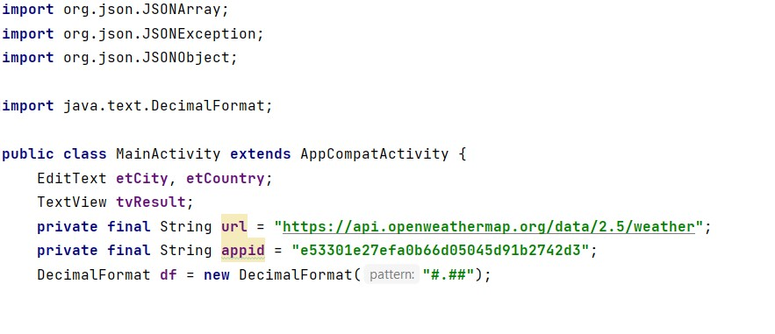
Code Analysis

Slide 31
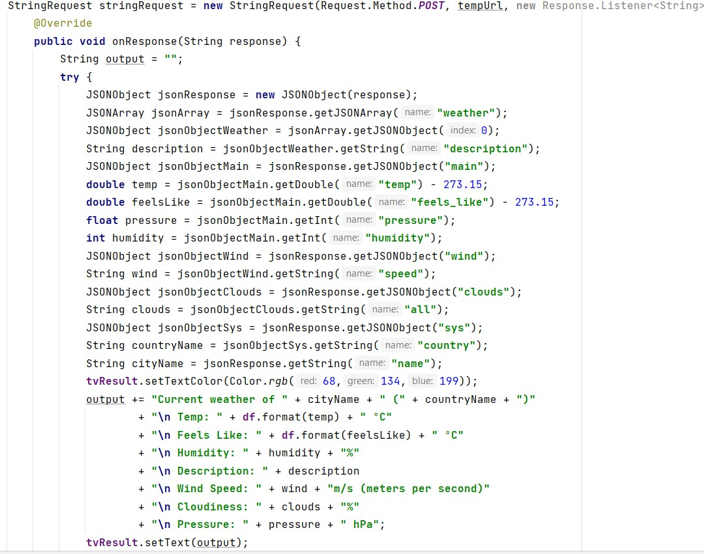
Code Analysis

Slide 32
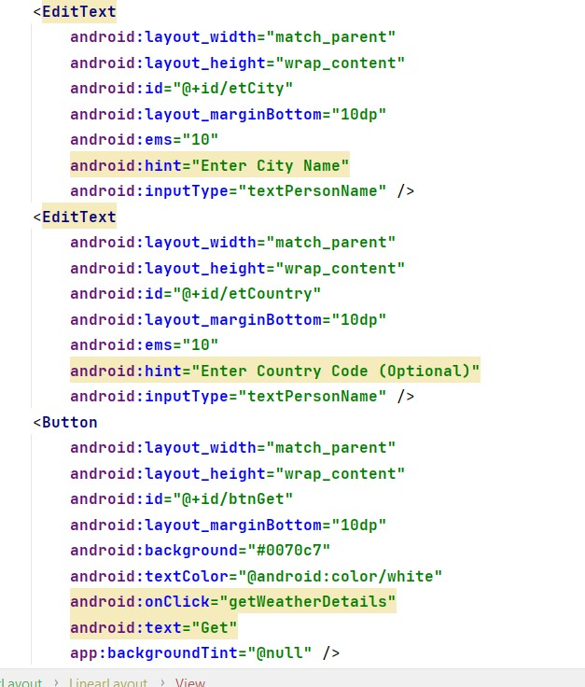
Code Analysis

Slide 33
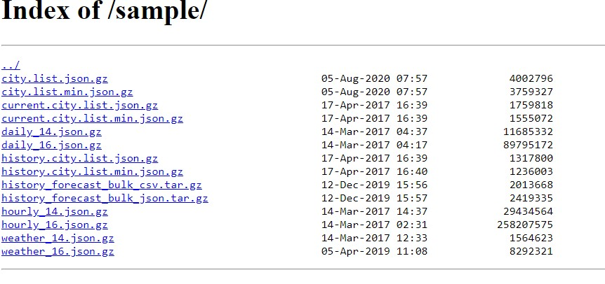
Introduction
Fetching
JSON files

Slide 34
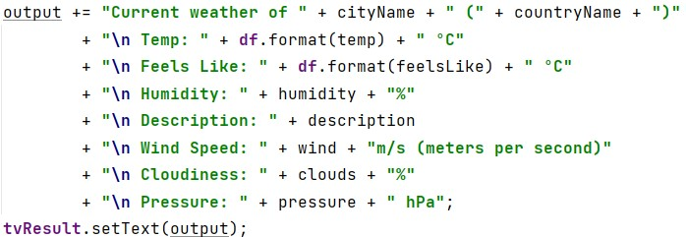
Introduction
Describing the Attributes

Slide 35
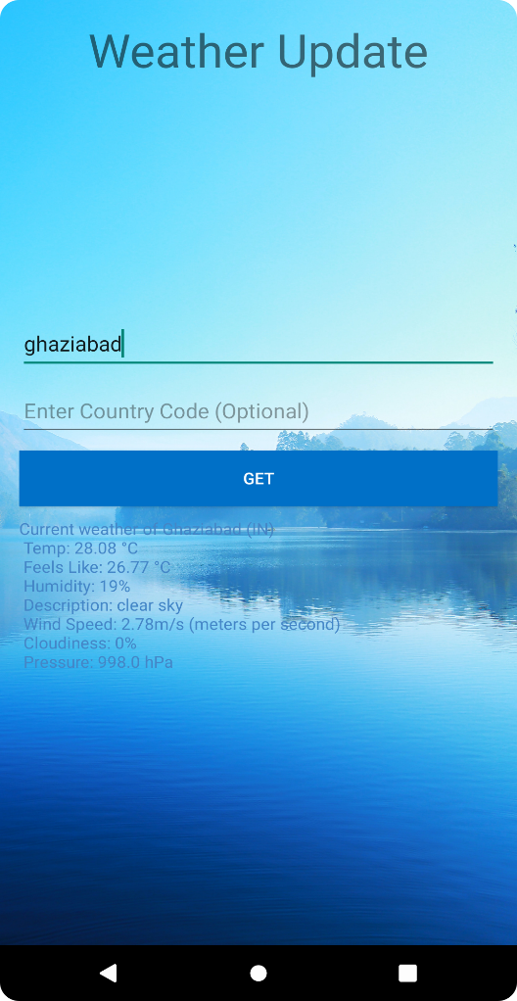
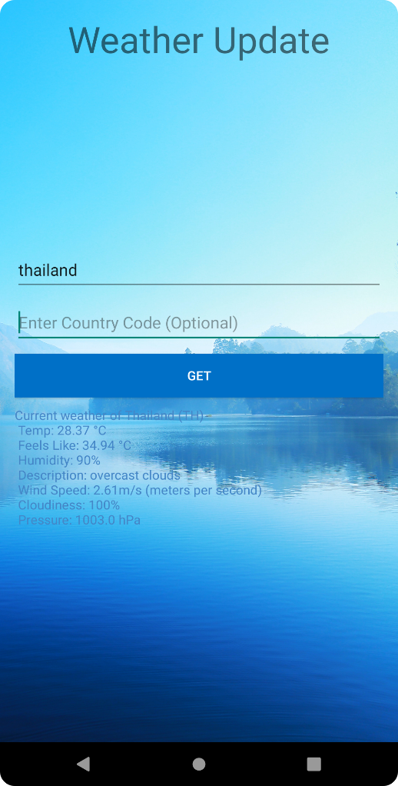
Conclusion And Result
In this strategy for anticipating climate expectation we present innovation in view of machine learning procedures just to give appropriate examination to weather conditions estimates in this paper. As well realized insightful models today made utilizing AI innovations that are a lot more straightforward tan regular actual model. They use assets In an extremely less sum and even that run practically any machine for anticipate the outcome including cell phones.
In later we wanted to gather more information connected with climate from an extraordinary specific area or region however from different parts on the off chance that the urban communities utilizing minimal expense internet of things gadgets like temperature and moistness sensors. We additionally found that the district that impact the atmospheric conditions and causing weighty precipitation, flood by tracked down the connection between the temperature and the scope additionally assists with grasping aggravation in the environment.

Slide 36
References
Project Idea from:
https://www.kaggle.com/salmamaamouri/weather-prediction-regression-neural-model
https://youtu.be/f2oSRBwN2HY
PPT template from:
Creative Area Chart | Free PowerPoint Template (24slides.com)
Content from:
Weather forecasting with data science approaches | by Andrii Shchur | Towards Data Science
Data science – Wikipedia
Data Science for Weather Prediction - The Prerequisite to all Natural Disasters - DataFlair (data-flair.training)

Slide 37
THANK YOU

